Slide 1
Festivals!
By TSSH

Slide 2
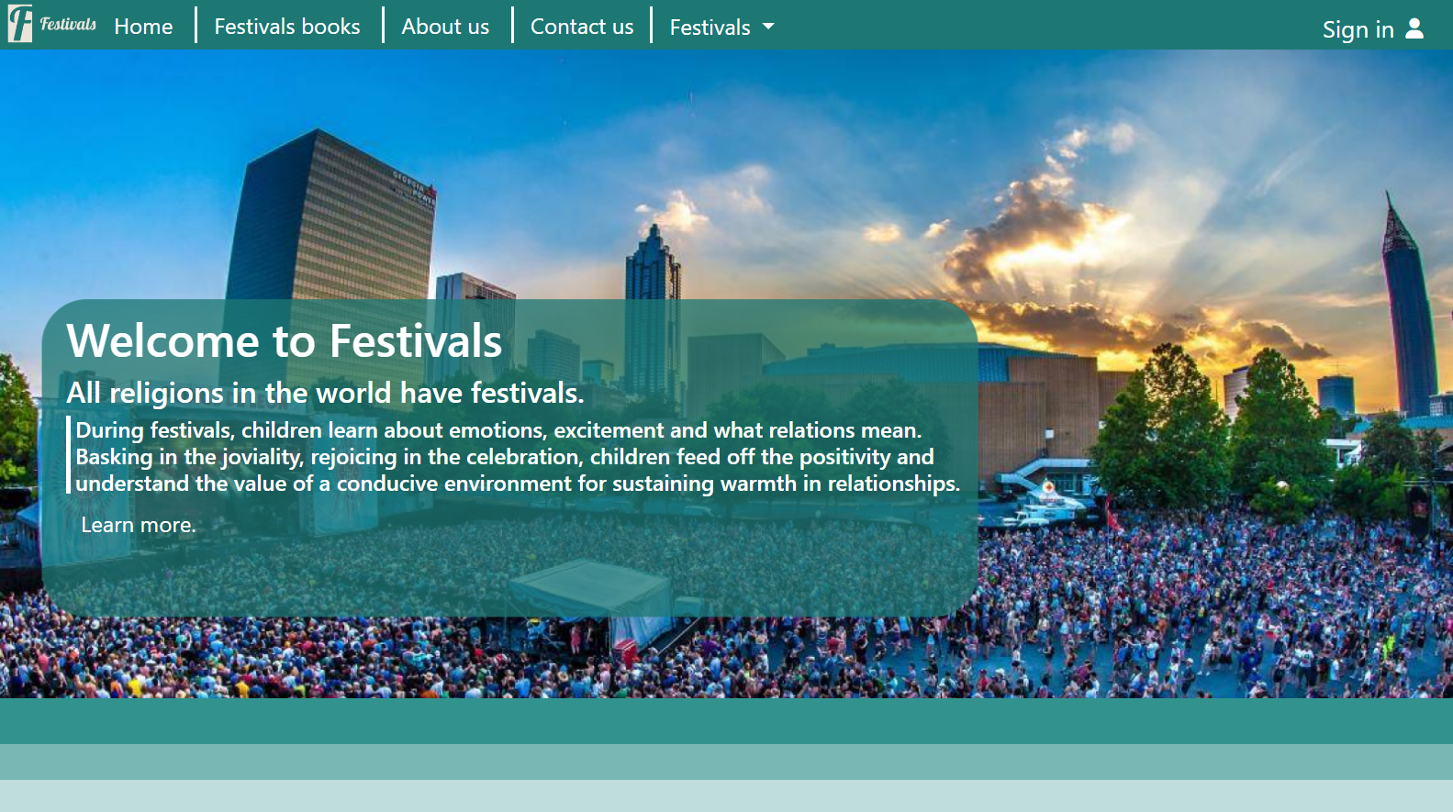
What is Festivals! ?
Festivals! Help people learn more about their festivals
Festivals! Is completely free

Slide 3
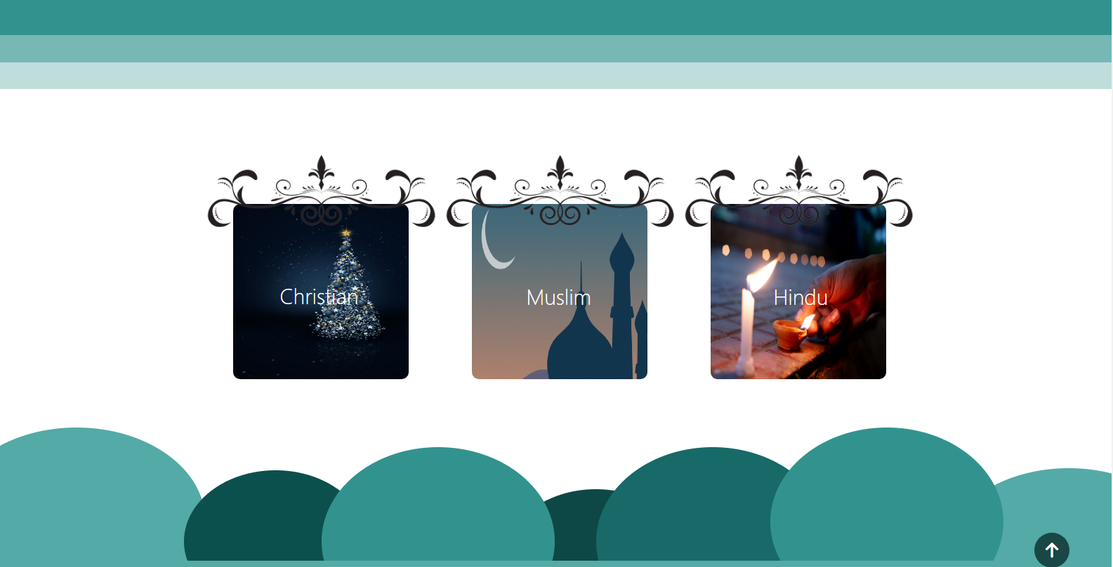
What is Festivals! About ?!?
Fesitvals! Is about religions holidays
Muslim
Hindu
Christan

Slide 4
How many religions in Festivals!
Muslim
Hindu
Christan
More soon.
muslim
hindu
christan

Slide 5
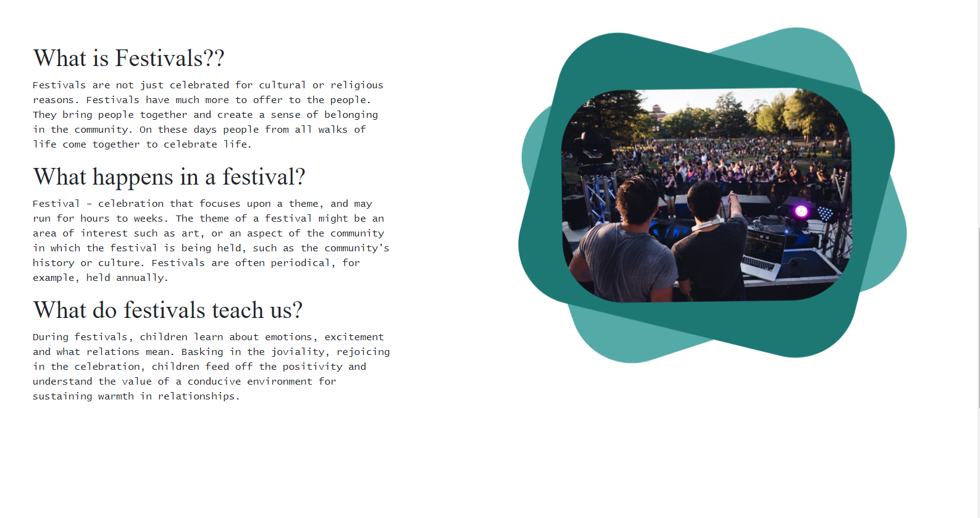
Home
Festivals home page is great!

Slide 6
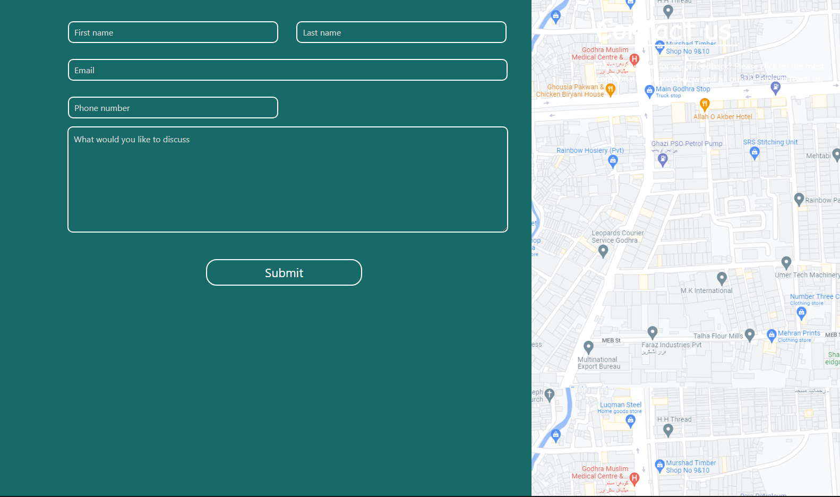
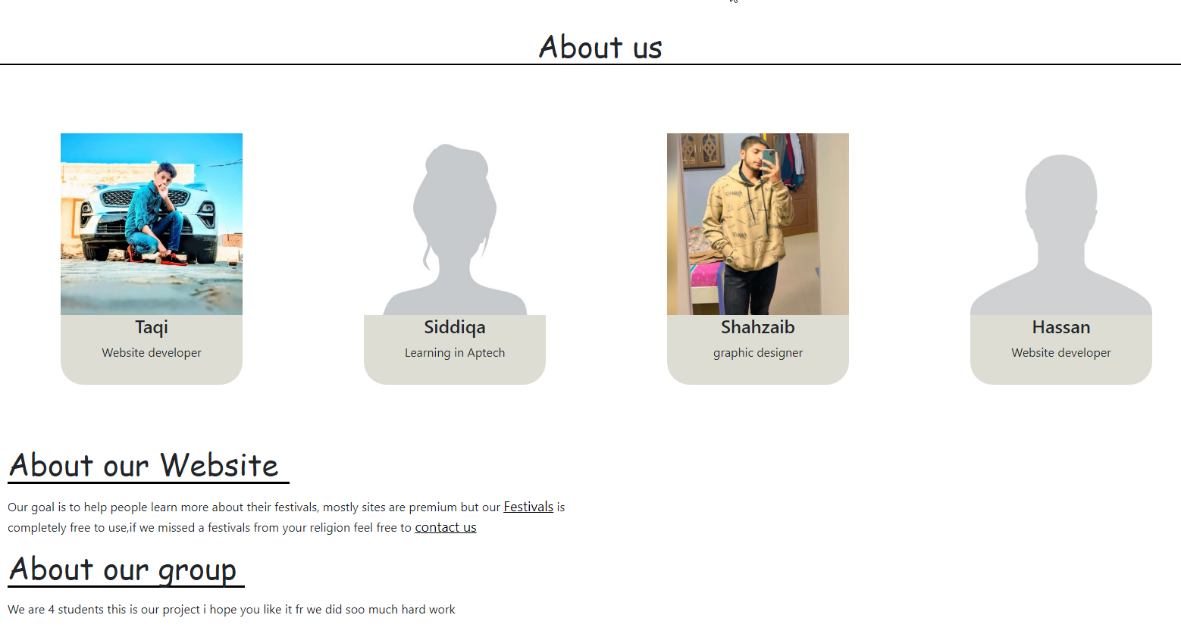
About creators
Contact us
About us

Slide 7
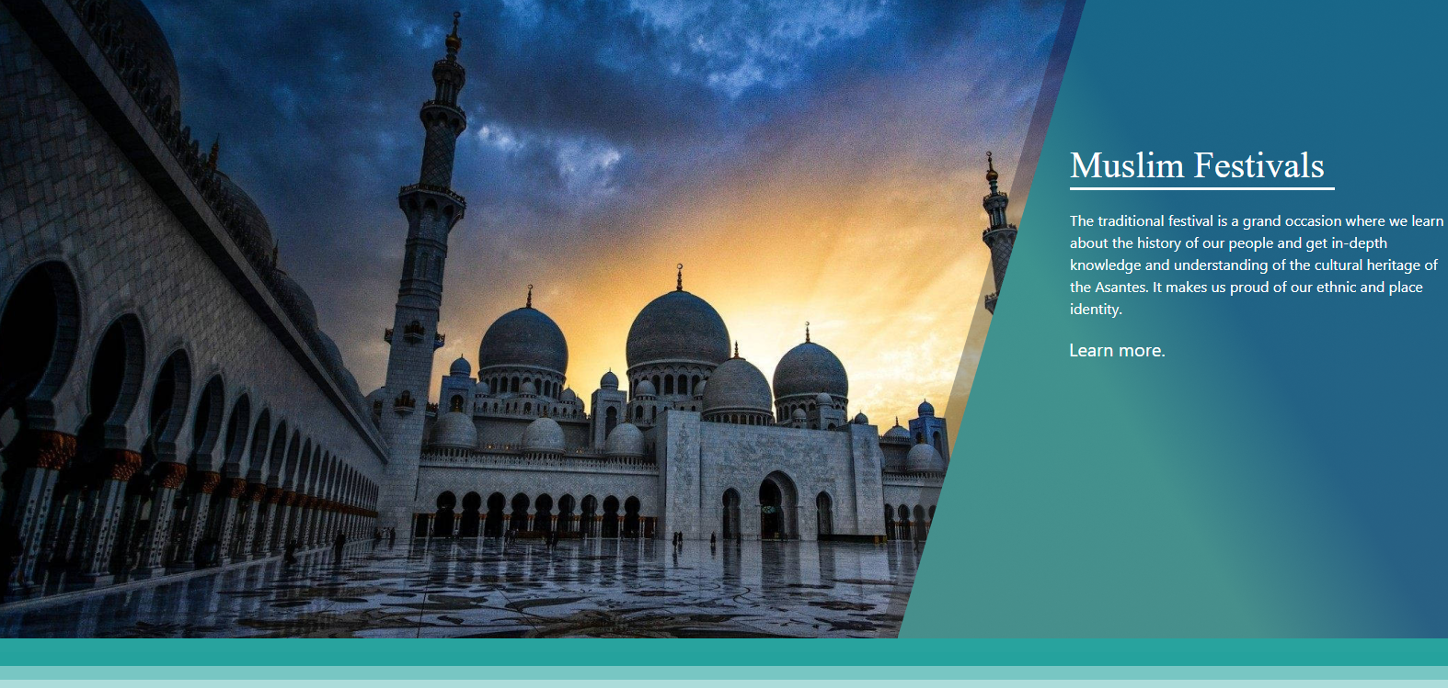
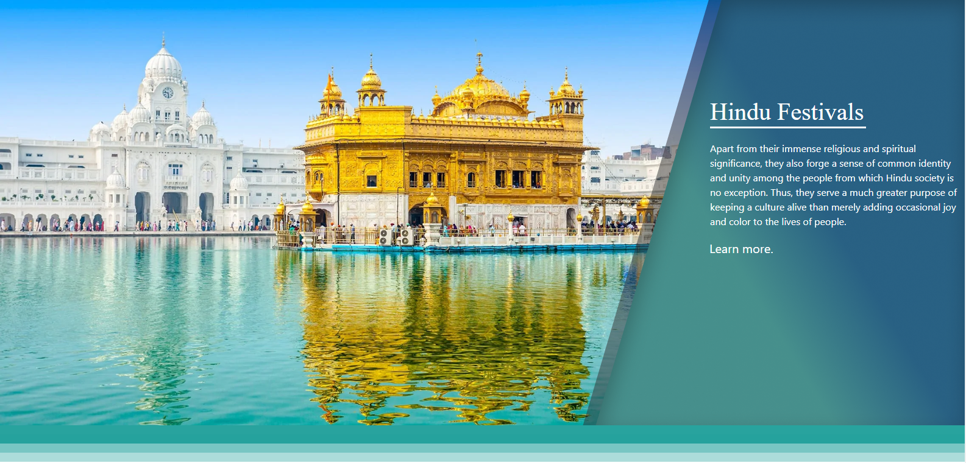
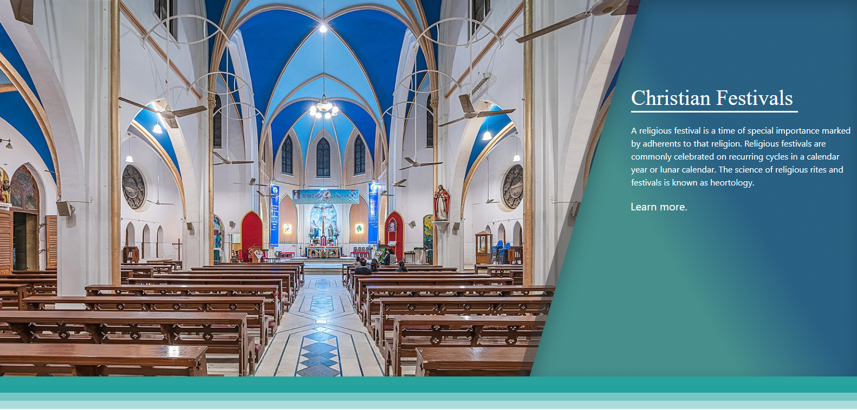
Festivals pages

Slide 8
fAQS about Festivals!
Q: Is there going to be more religions ??
A: Yes very soon we are going to add more religions
Q: where can I buy Festivals! Books?
A: at our Festivals! Book section
Q: do I need to sign in to use Festivals!
A: no need at all but if you're about to buy Festivals book then yes!

Slide 9
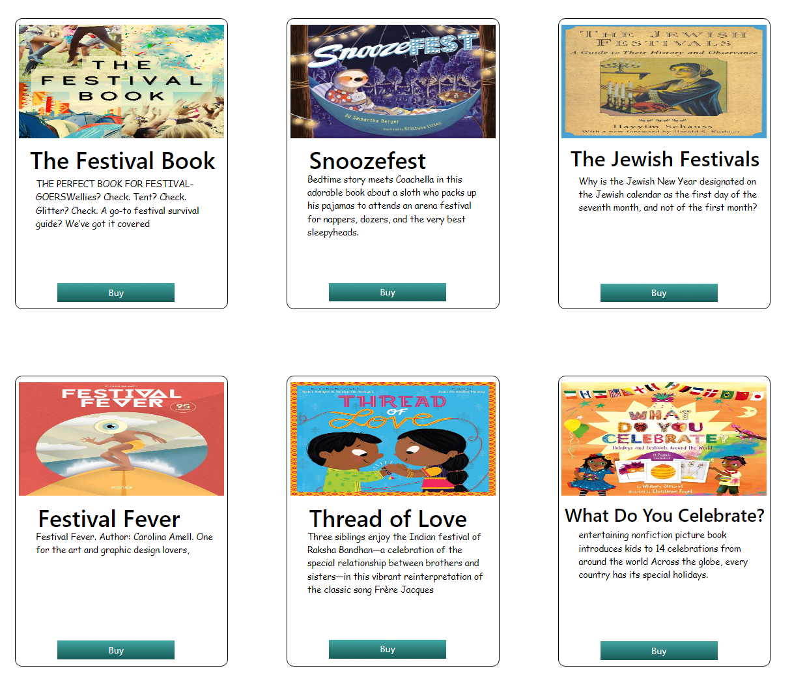
Festivals! books
In Festivals! Books you can buy books from different religions

Slide 10

Thank you

